Slide 1


Introduction to
INFORMATION
MANAGEMENT SYSTEM
LESSON 1
CLARK COLLEGE
OF SCIENCE AND TECHNOLOGY
PREPARED BY: MR. JOMAR G. SANGIL

Slide 2
TOPICS
01
DIFFERENCE OF DATA AND INFORMATION
04
KEY COMPONENTS OF INFORMATION SYSTEM
02
05
3 ACTIVITIES IN AN INFORMATION SYSTEM TO PRODUCE INFORMATION
TYPES OF DATA
03
TRANSFORMING DATA INTO INFORMATION
06
DIMENSIONS OF INFORMATION SYSTEMS

Slide 3
What is Data?

Slide 4

DATA
it consists of raw facts.
Examples 311, 18, Victoria

Slide 5
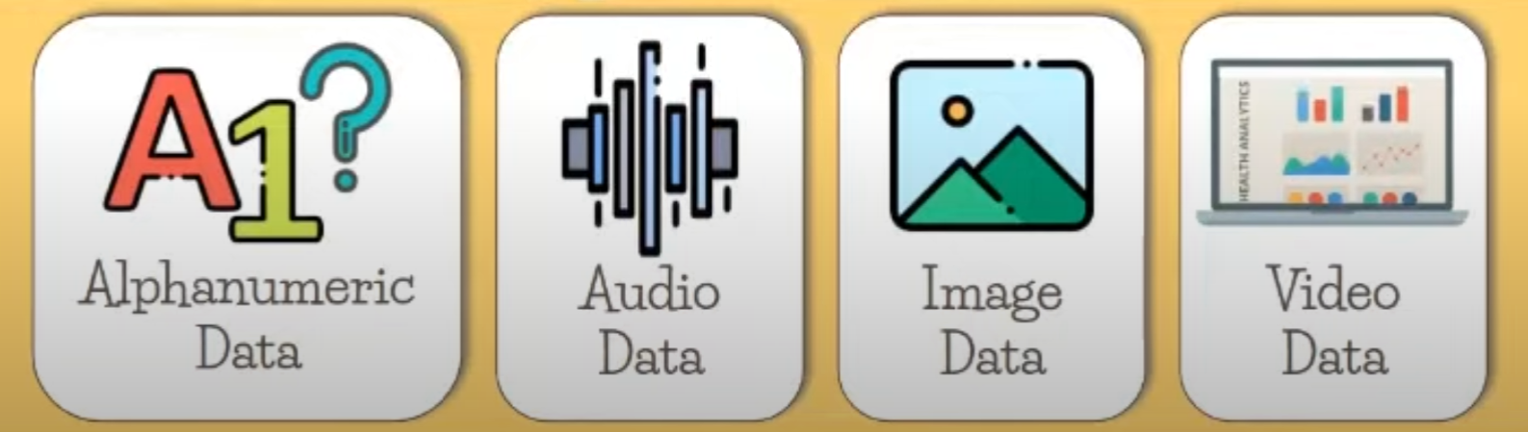
TYPES OF DATA

Slide 6
What is Information?

Slide 7
INFORMATION
It is a collection of data organized and processed so that it has additional value beyond the value of the individual facts.

Slide 8

INFORMATION
Example:
311
Sale for August 1, 2024

Slide 9
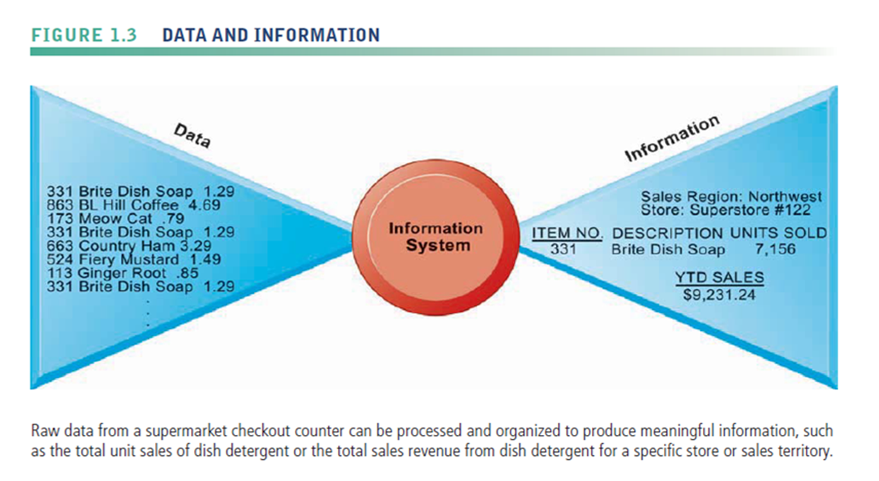
EXAMPLE OF DATA AND INFORMATION

Slide 10

INFORMATION SYSTEM
It is a set of interrelated components that collect, process, store, and disseminate data and information. It provides a feedback mechanism to monitor and control its operation to make sure it continues to meet its goals and objectives.

Slide 11


INFORMATION SYSTEM
Example
1
2

Slide 12
FIVE KEY COMPONENTS ON INFORMATION SYSTEM
Hardware
Software
Data
Processes
People

Slide 13
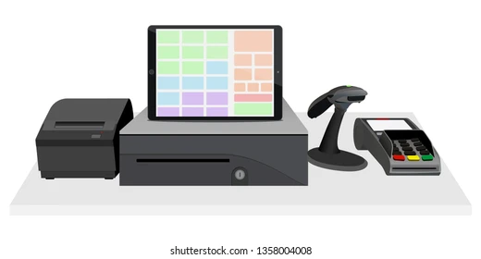
HARDWARE
– refers to the physical layer of the information system. Hardware includes computers, networks, communications equipment, scanners, digital capture devices, and other technology-based infrastructure.

Slide 14

SOFTWARE
consists of system software and application software.

Slide 15
DATA
An information system transforms data into useful information

Slide 16
PROCESSES OR PROCEDURES
describe the tasks that users, managers, and IT staff members perform. Processes necessary to support a specific business model are described in written documentation manuals and online reference materials.

Slide 17

PEOPLE
also known as users or end-users. Users include employees, customers, vendors, and others who interact with an information system.

Slide 18
TWO TYPES OF USERS
Internal users – include managers, technicians, sales rep, and corporate officers.
External users - include customers who track their orders on the company’s Web site, suppliers who use a customer’s system to plan their manufacturing schedules

Slide 19
3 ACTIVITIES IN AN INFORMATION SYSTEM TO PRODUCE INFORMATION
Input
It captures or collect raw data from within the organization or from its external environment
2. Processing
It converts the raw input into meaningful form.
3. Output
It transfers the processed data to the people who will use it or to the activities for which it will be used.

Slide 20
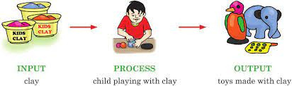
3 ACTIVITIES IN AN INFORMATION SYSTEM TO PRODUCE INFORMATION
Input, Processing and Output (IPO)

Slide 21
3 ACTIVITIES IN AN INFORMATION SYSTEM TO PRODUCE INFORMATION
Input, Processing and Output (IPO)
INPUT
PROCESS
OUTPUT
Data
Information
Resources
Activities
Transformations
Operations
Result
Product
Outcome

Slide 22
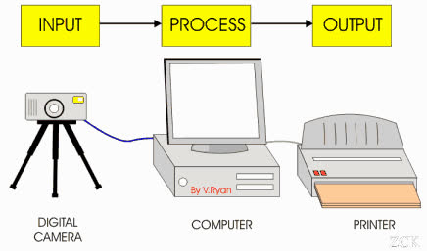
3 ACTIVITIES IN AN INFORMATION SYSTEM TO PRODUCE INFORMATION
Input, Processing and Output (IPO)

Slide 23
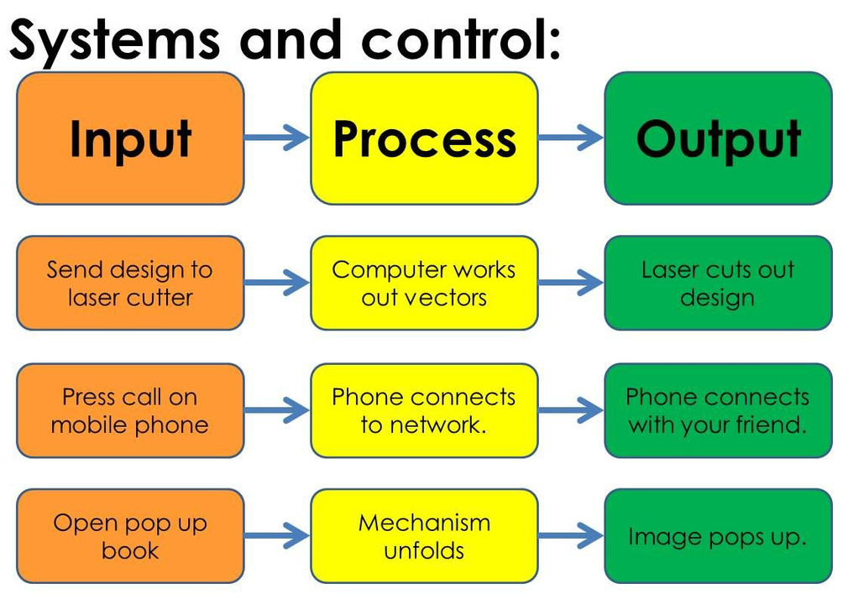
3 ACTIVITIES IN AN INFORMATION SYSTEM TO PRODUCE INFORMATION
Input, Processing and Output (IPO)

Slide 24
ACTIVITY TIME
Write an example of an IPO (Input-Process-Output). This exercise will help you understand how to break down a system or a task into its essential components.
Task
Choose a Simple Task or System: Select a task or system that can be easily broken down into inputs, processes, and outputs. Examples include making a cup of coffee, calculating the average of numbers, or logging into a website.
Write Your Example:
Clearly label each section (Input, Process, Output).
Use bullet points or a table format for clarity.
Ensure your example is simple and easy to understand.

Slide 25
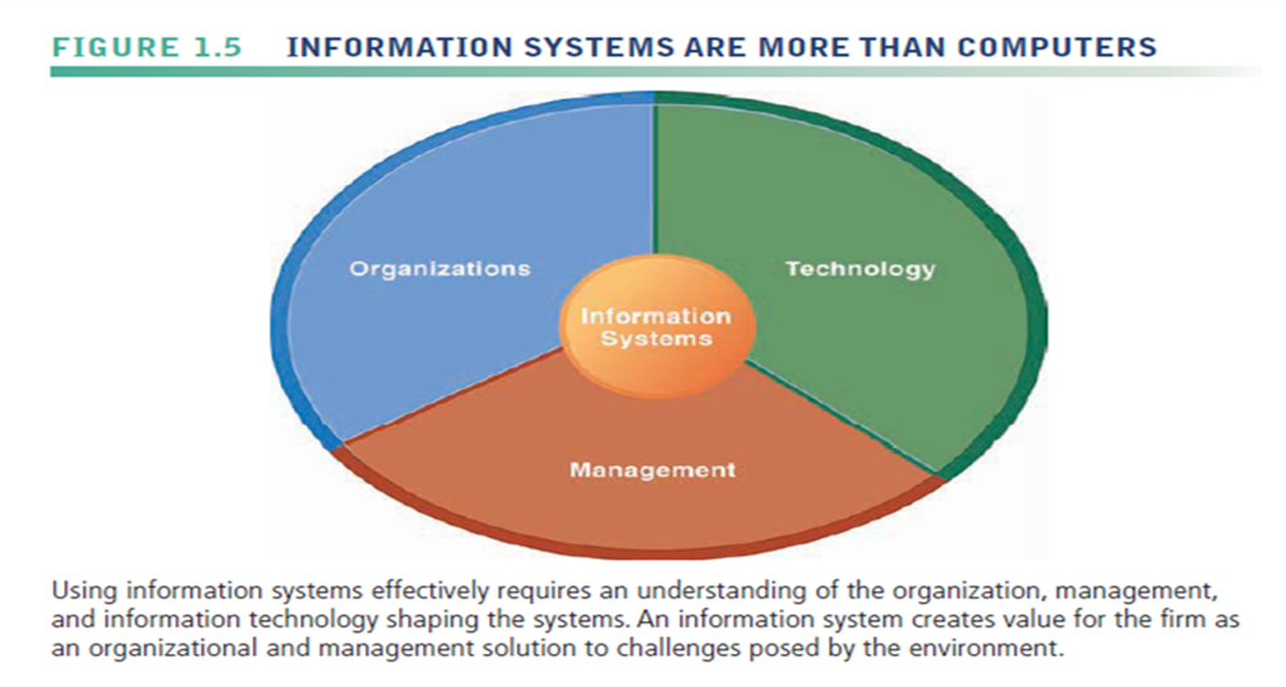
DIMENSIONS OF INFORMATION SYSTEMS

Slide 26
ORGANIZATIONS
•These are firms/companies who handle or need the information systems to transact business.
•The key elements of an organization are its people, structure, business processes, politics and culture.
•It has structure that is composed of different levels and specialties.

Slide 27
MANAGEMENT
•Management’s job is to make sense out of many situations faced by organizations, make decisions, and formulate action plans to solve organizational problems.

Slide 28
MANAGEMENT
•Managers perceive business challenges in the environment. They set the organizational strategy for responding to those challenges and they allocate the human and financial resources to coordinate the work and achieve success.

Slide 29
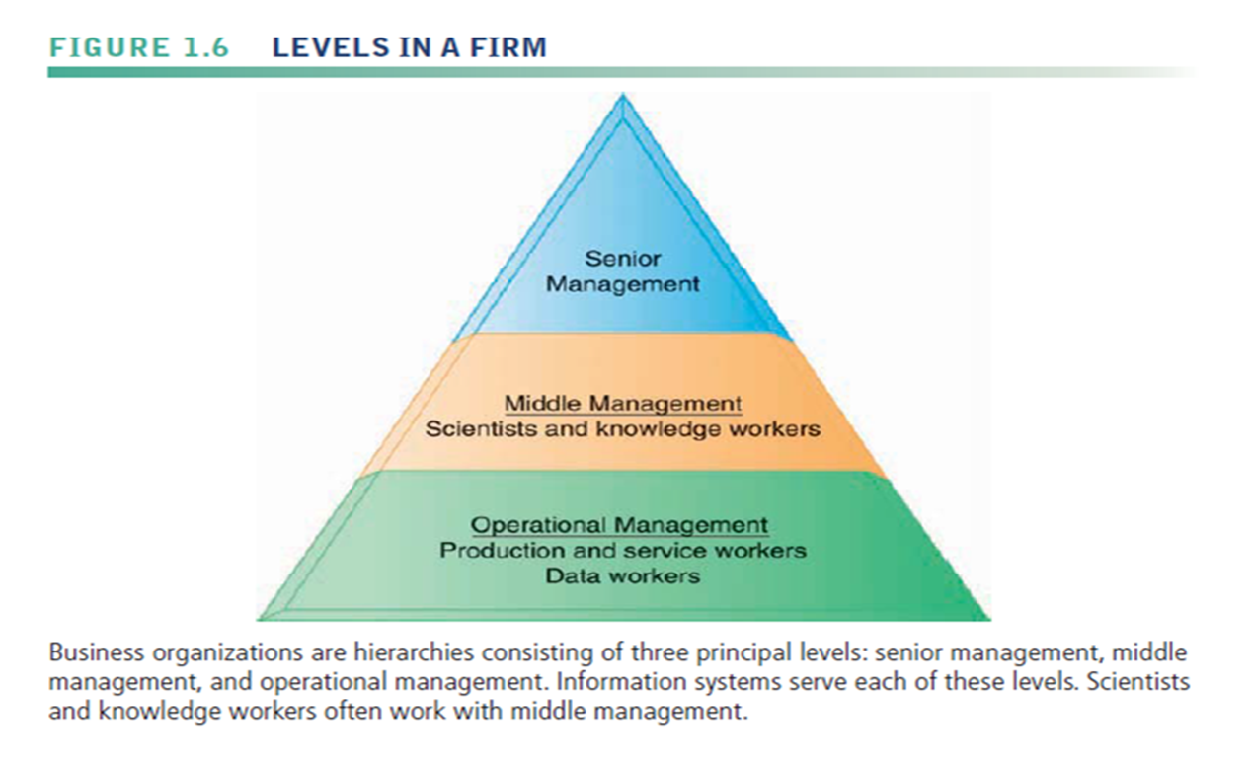
LEVELS OF MANAGEMENT

Slide 30
SENIOR MANAGEMENT
/ TOP MANAGEMENT
Top manager develop long-range plans, called strategic plans that define the company’s overall mission and goals. Strategic planning focuses on issues that affect the company’s future survival and growth, including long-term IT plans.

Slide 31
MIDDLE MANAGEMENT
They carry out the programs and plans of senior management/top management. The knowledge workers are under this category like engineers, scientists or architects design products and create new knowledge.

Slide 32
OPERATIONAL MANAGEMENT
They are responsible for monitoring the daily activities of the business. The data workers and production or service workers are under this category.

